Slide 1
Spiers Magic Wand Critical Design Review

Slide 2




The A Team
Matthew Fossett Project Manager
Darrell Smith Hardware Developer
Kevin “Cale” Coor Hardware Developer
Logan Sinclair Software Developer

Slide 3
Requirements
1. Scan a 2D barcode.
2. Be wireless.
3. Call a webservice with parameters: 2D barcode and Magic Wand ID (MWID). With this approach we can reprogram the behavior of each magic wand in ALFRED.
4. Provide some type of feedback to the magic wand user. Possibly lightning or a Tesla Coil type effect.
5. Look powerful, awesome, and hilarious.

Slide 4
Bill Of Materials
Final Cost

Slide 5
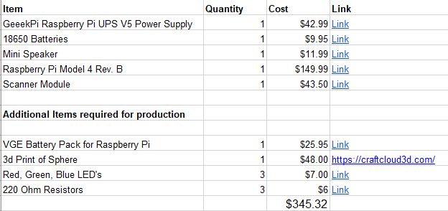
BOM
We didn’t account for some items in the initial parts list, those are included in the second section

Slide 6
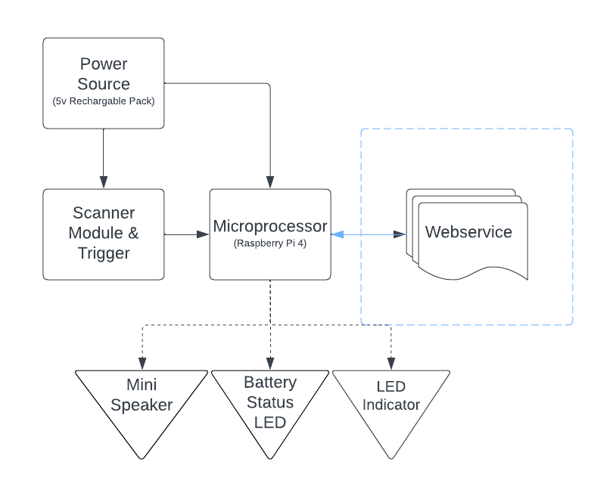
Block Diagram
5 V
4A
5 V 83 mA
3.3 V
70 mA
5 V 1.5 A
5 V 16mA

Slide 7
Schematics

Slide 8
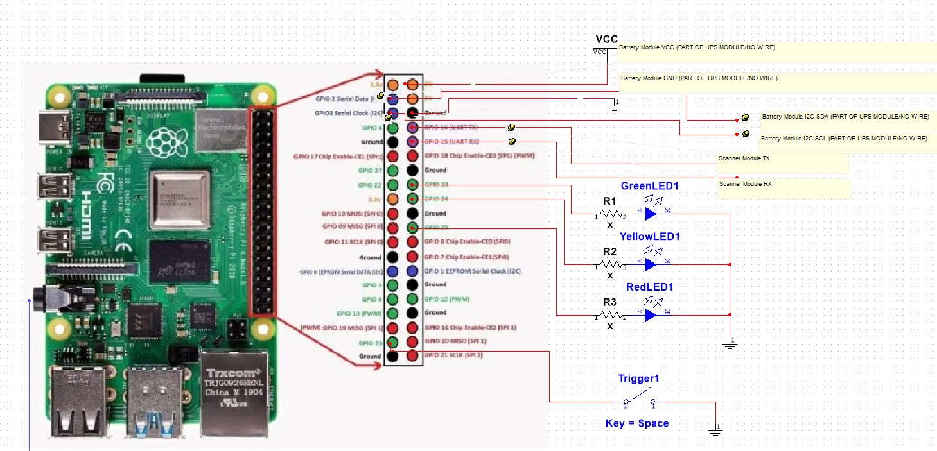
Raspberry Pi
https://datasheets.raspberrypi.com/rpi4/raspberry-pi-4-datasheet.pdf

Slide 9

Audio Amplifier
https://www.amazon.com/Ximimark-1-8-12V-TDA2822M-Amplifier-Channel/dp/B07KC1CZWY

Slide 10
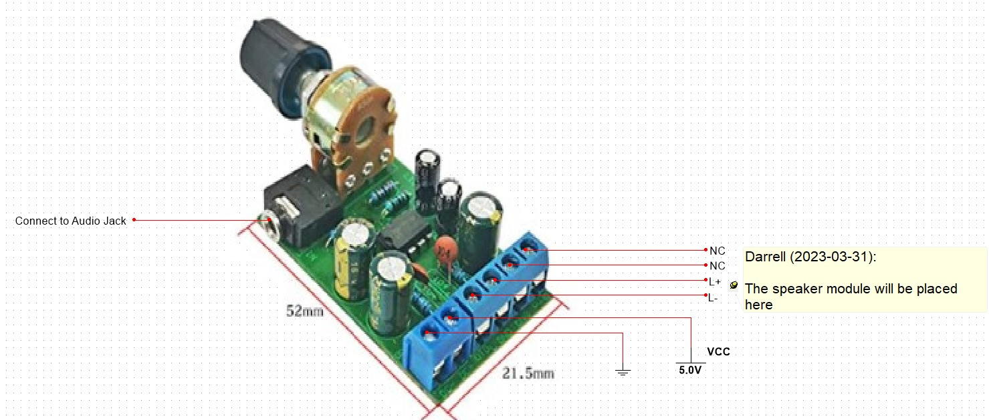
Audio Amplifier
https://www.amazon.com/Ximimark-1-8-12V-TDA2822M-Amplifier-Channel/dp/B07KC1CZWY

Slide 11
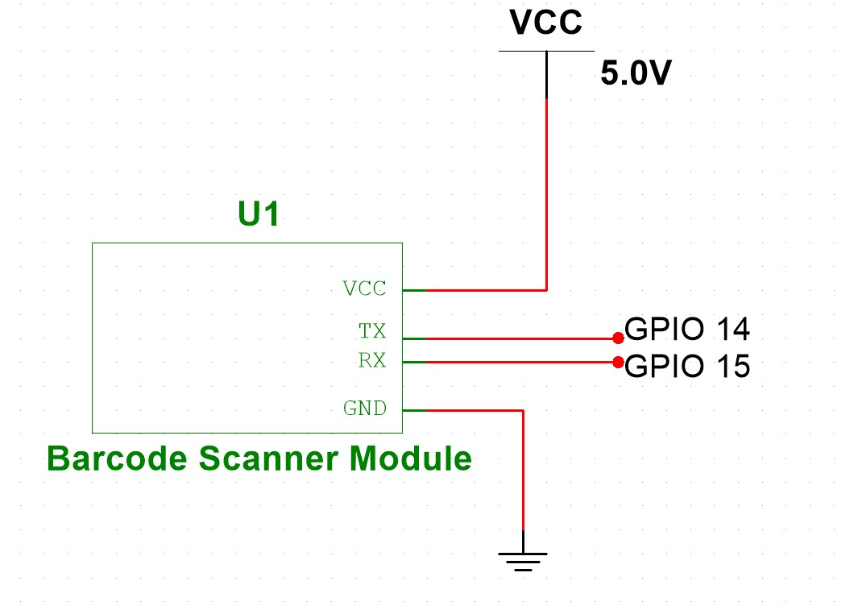
Scanner Module
https://www.waveshare.com/w/upload/archive/3/3c/20180623102926%21Barcode_Scanner_Module_User_Manual_EN.pdf

Slide 12
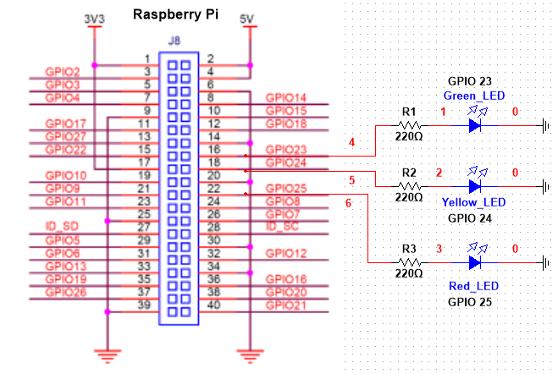
LED Indicators

Slide 13
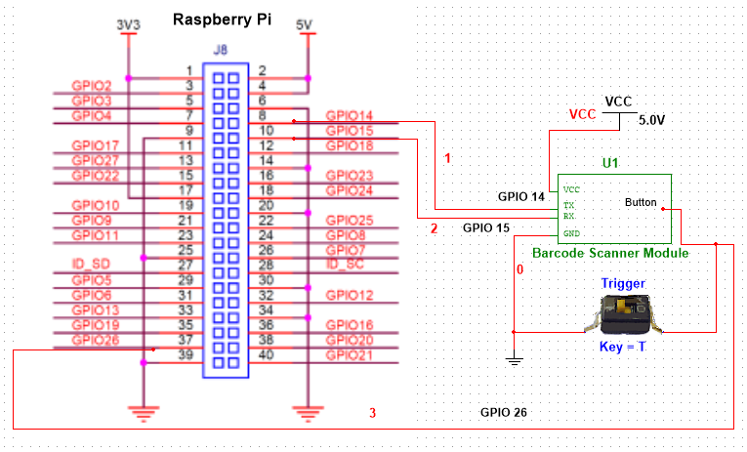
Trigger

Slide 14
Software Block Diagram

Slide 15
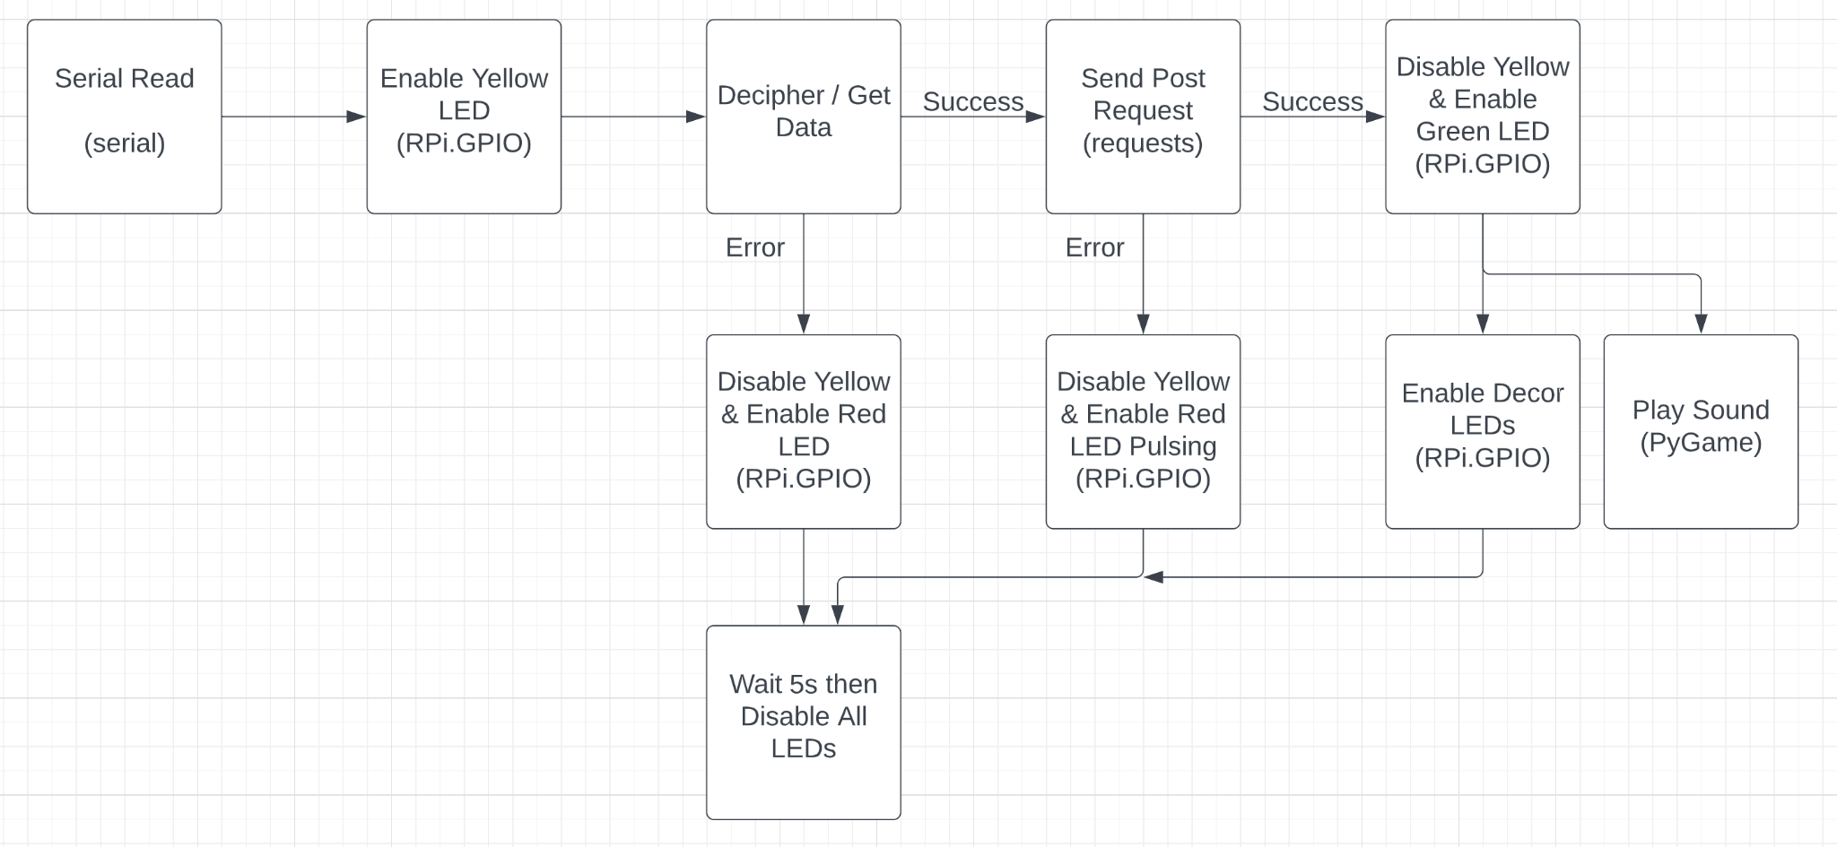
Software Block Diagram - Main

Slide 16
CAD Design

Slide 17
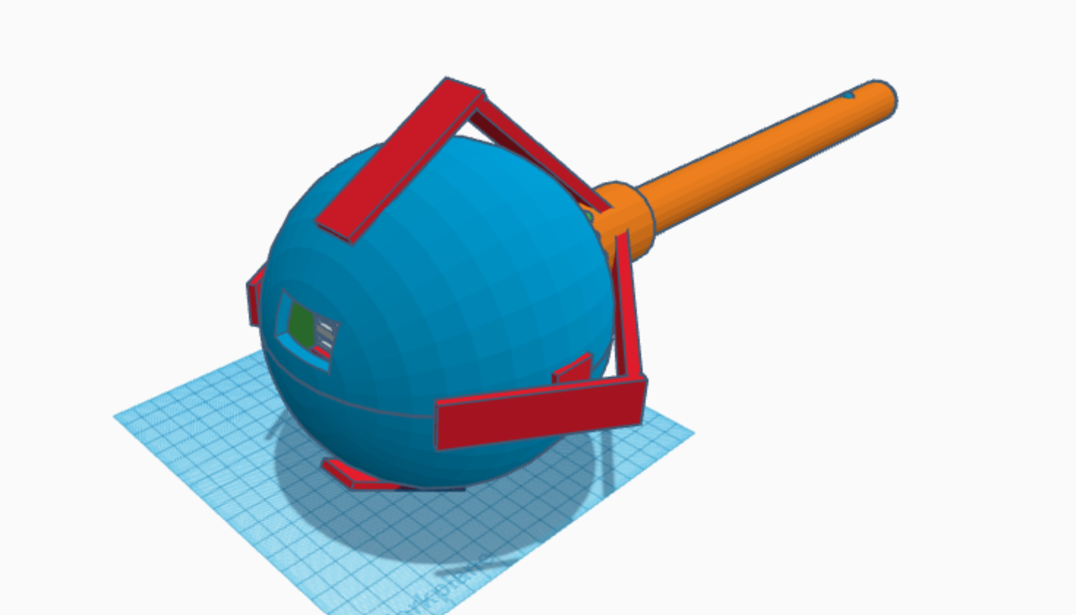
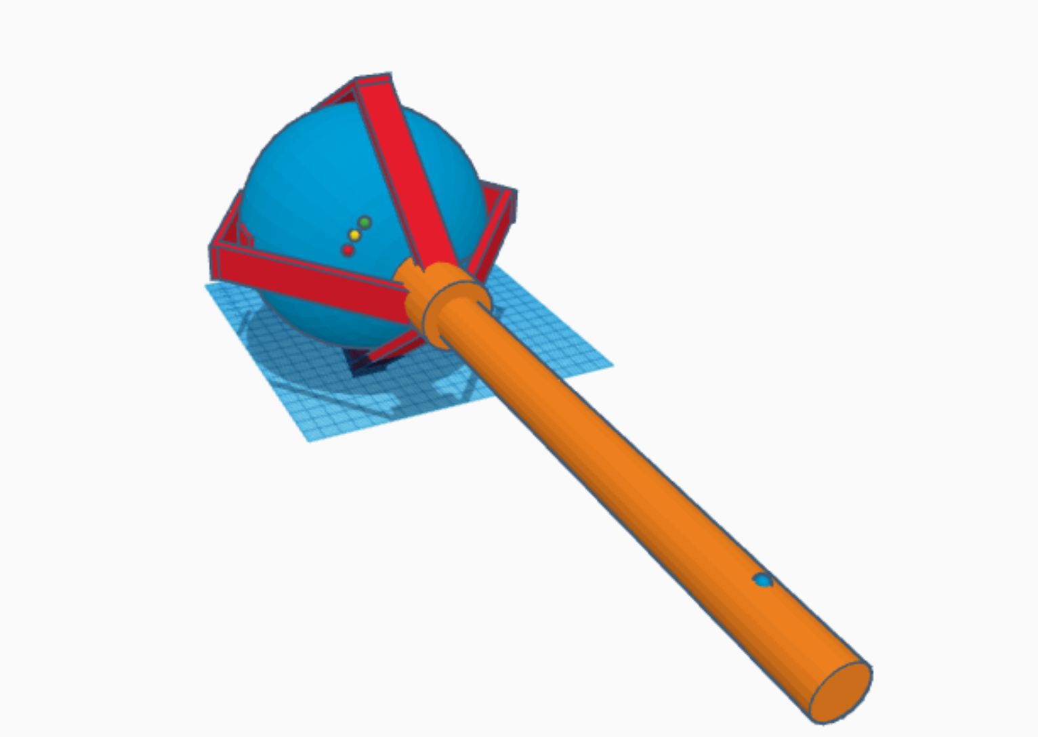
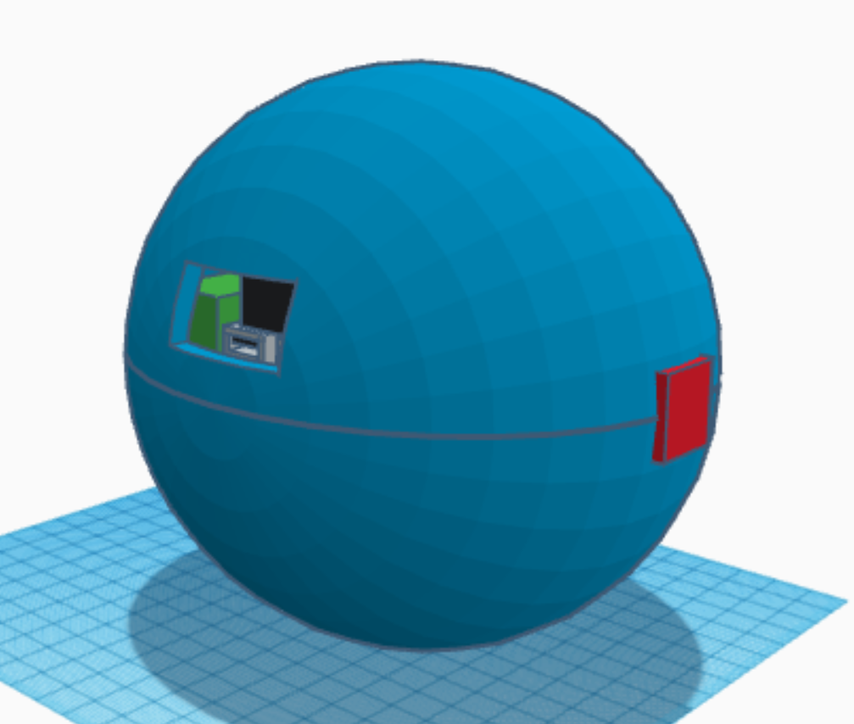
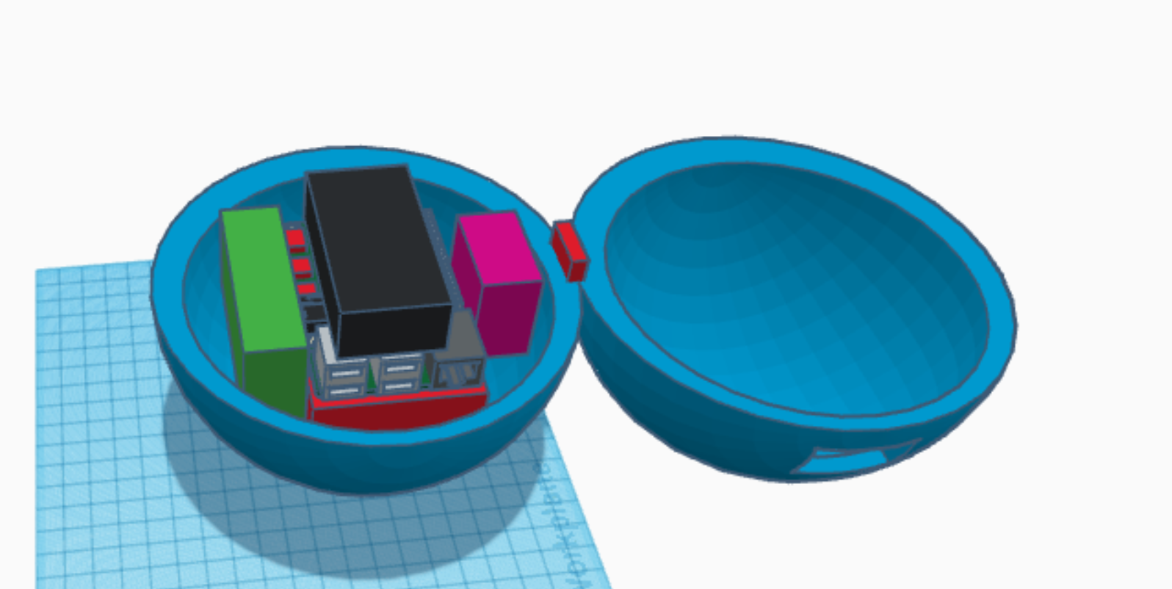
Raspberry Pi Model by TinkerCAD User: nledevil

Slide 18
Live Demo
Any questions?

